Slide 1
The Nervous System
MICHAEL NTIM (Ph.D.)
Phone No: 0507497320
Email: archangelmntim@yahoo.co.uk

Slide 2
Objectives
By the end of the lesson, students should be able to;
State the divisions of the nervous system
List the types of nervous tissue
Describe action potential generation and propagation
Describe sensory physiology and communication between cells
Describe the sensory and motor system
Differentiate between the functions of the sympathetic and the parasympathetic system

Slide 3
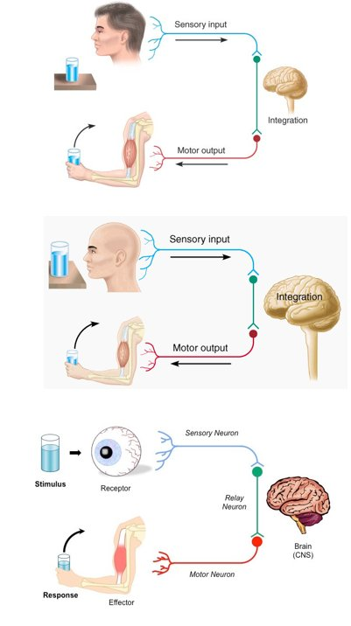
The Nervous System

Slide 4
Functions of the Nervous System
1. Sensory input – gathering information
To monitor changes occurring inside and outside the body (changes = stimuli)
2. Integration –
To process and interpret sensory input and decide if action is needed.
3. Motor output
A response to integrated stimuli
The response activates muscles or glands

Slide 5
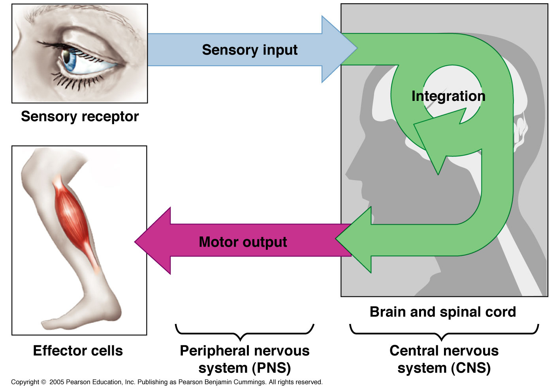

Slide 6
Nervous vs. Endocrine System
Similarities:
They both monitor stimuli and react so as to maintain homeostasis.
Differences:
The NS is a rapid, fast-acting system whose effects do not always persevere.
The ES acts slower (via blood-borne chemical signals called H _ _ _ _ _ _ _) and its actions are usually much longer lasting.

Slide 7
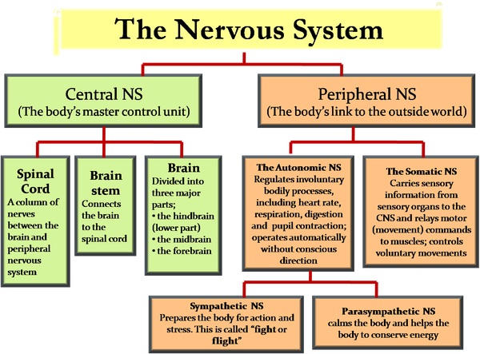

Slide 8
Peripheral Nervous System
Responsible for communication between the CNS and the rest of the body.
Can be divided into:
Sensory Division
Afferent division
Conducts impulses from receptors to the CNS
Informs the CNS of the state of the body interior and exterior
Sensory nerve fibers can be somatic (from skin, skeletal muscles or joints) or visceral (from organs w/i the ventral body cavity)
Motor Division
Efferent division
Conducts impulses from CNS to effectors (muscles/glands)
Motor nerve fibers

Slide 9
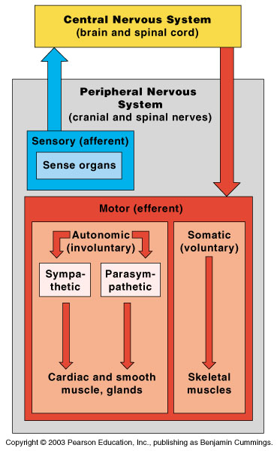
Organization of the Nervous System

Slide 10
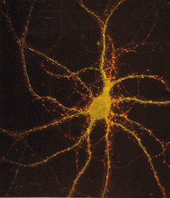
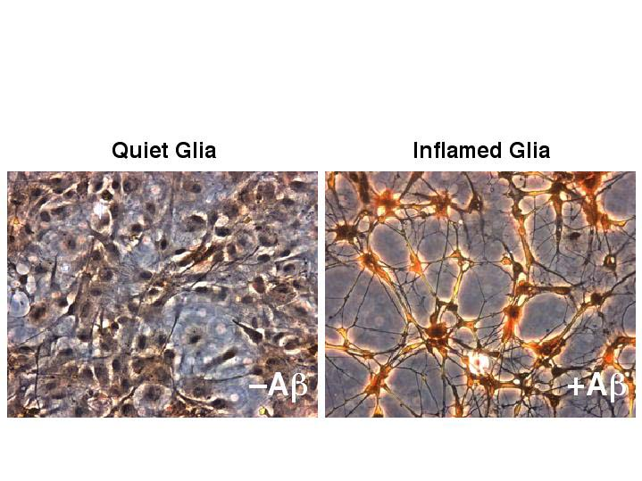
Nervous Tissue
1.
Highly cellular
How does this compare to the other 3 tissue types?
2 cell types
Neurons
Functional, signal conducting cells
Neuroglia
Supporting cells
2.

Slide 11
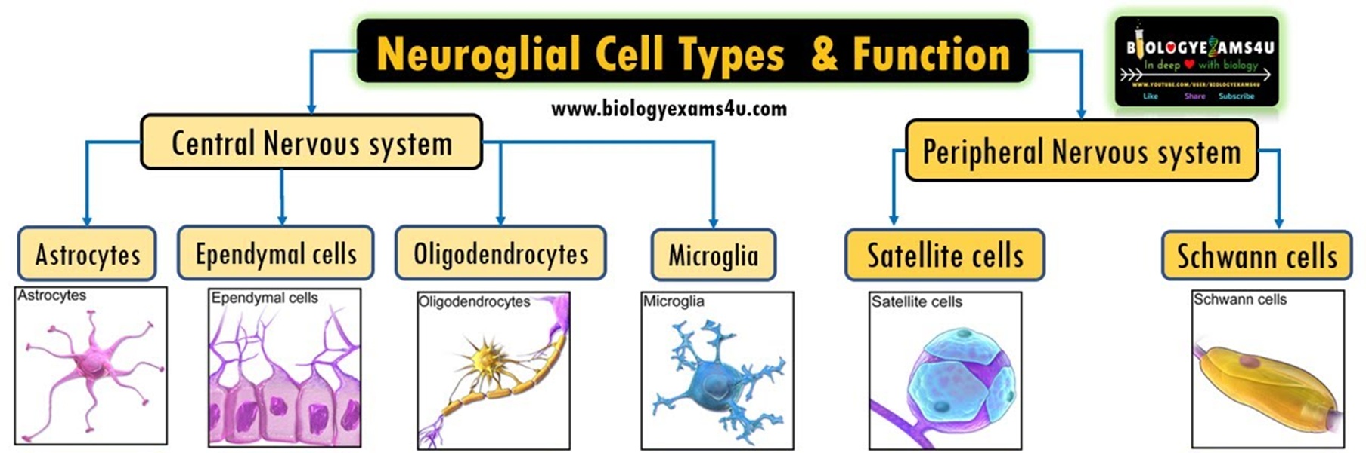
Neuroglia
Outnumber neurons by about 10 to 1

Slide 12
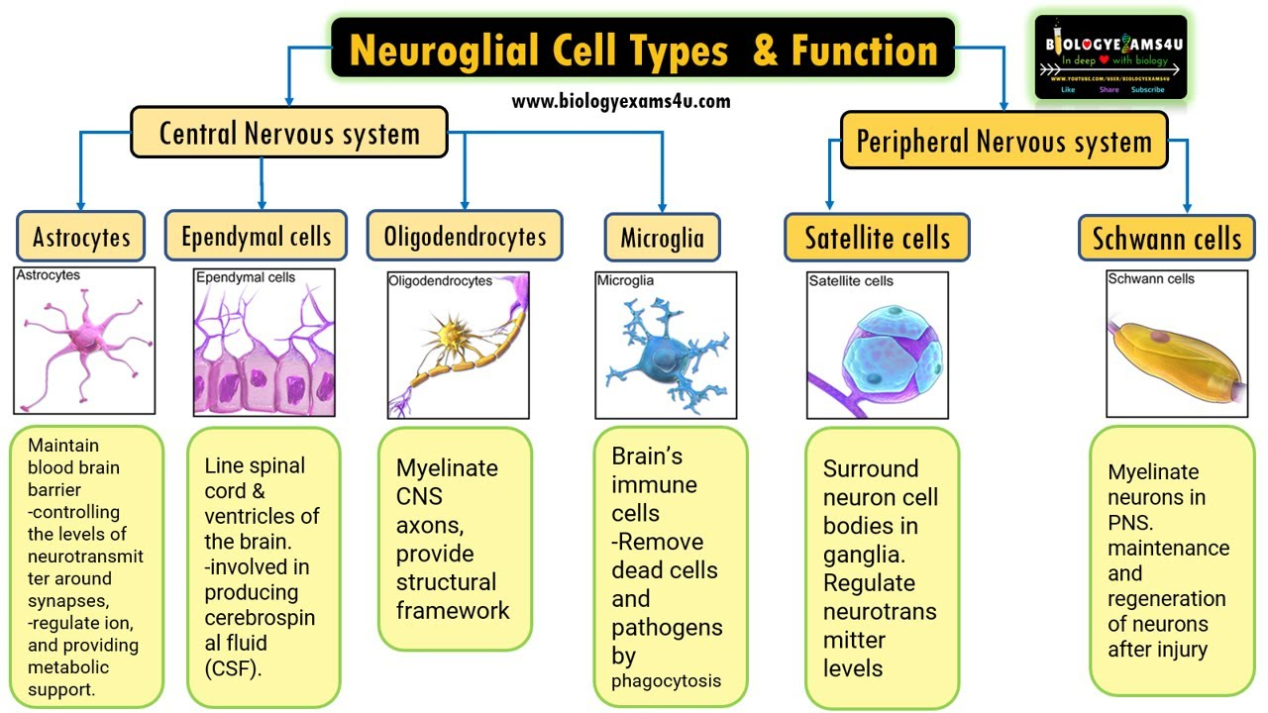

Slide 18
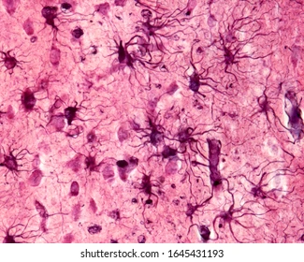
Neuroglia
Astrocytes
Star-shaped, abundant, and versatile
Guide the migration of developing neurons
Act as K+ and NT buffers
Involved in the formation of the blood brain barrier
Function in nutrient transfer

Slide 19
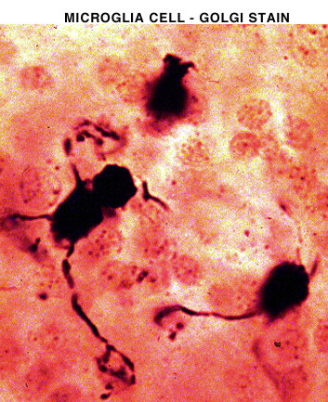
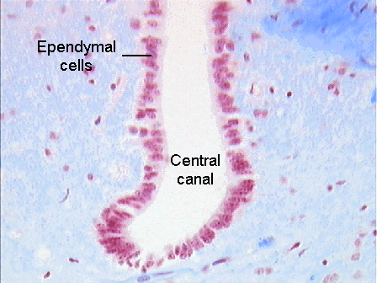
Neuroglia
Microglia
Specialized immune cells that act as the macrophages of the CNS
Why is it important for the CNS to have its own army of immune cells?
Ependymal Cells
Low columnar epithelial-esque cells that line the ventricles of the brain and the central canal of the spinal cord
Some are ciliated which facilitates the movement of cerebrospinal fluid

Slide 20
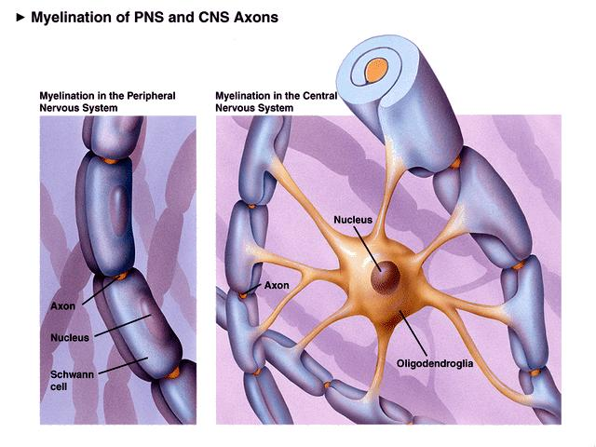
Neuroglia
4. Oligodendrocytes
Produce the myelin sheath which provides the electrical insulation for certain neurons in the CNS

Slide 21
Neuroglia
2 types of glia in the PNS
Satellite cells
Surround clusters of neuronal cell bodies in the PNS
Unknown function
Schwann cells
Form myelin sheaths around the larger nerve fibers in the PNS.
Vital to neuronal regeneration

Slide 22
Neuroglia vs. Neurons
Neuroglia divide but Neurons do not.
Most brain tumors are “gliomas.”
Most brain tumors involve the neuroglia cells, not the neurons.

Slide 23
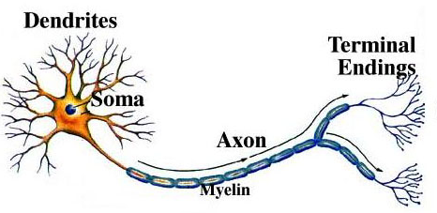
Neurons
The functional and structural unit of the nervous system.
Specialized to conduct information from
one part of the body to another.
There are many, many different types of neurons but most have certain structural and functional characteristics in common:
Cell body (soma)
One or more specialized, slender processes (axons/dendrites)
An input region (dendrites/soma)
A conducting component (axon)
A secretory (output) region (axon terminal)

Slide 24
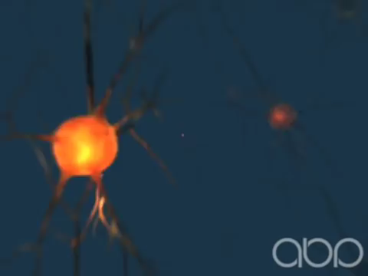

Slide 25
1 min Question
Neurons connect directly with each other at the terminals.
True
False
Yellow
Green

Slide 26
1 min Question
Neurons connect directly with each other at the terminals.
True
False
Green

Slide 27
Axons and Nerve Impulses
Axons end in axonal terminals.
Axonal terminals contain vesicles with neurotransmitters.
Axonal terminals are separated from the next neuron by a gap
Synaptic cleft – the gap between adjacent neurons
Synapse – the junction between nerves

Slide 28
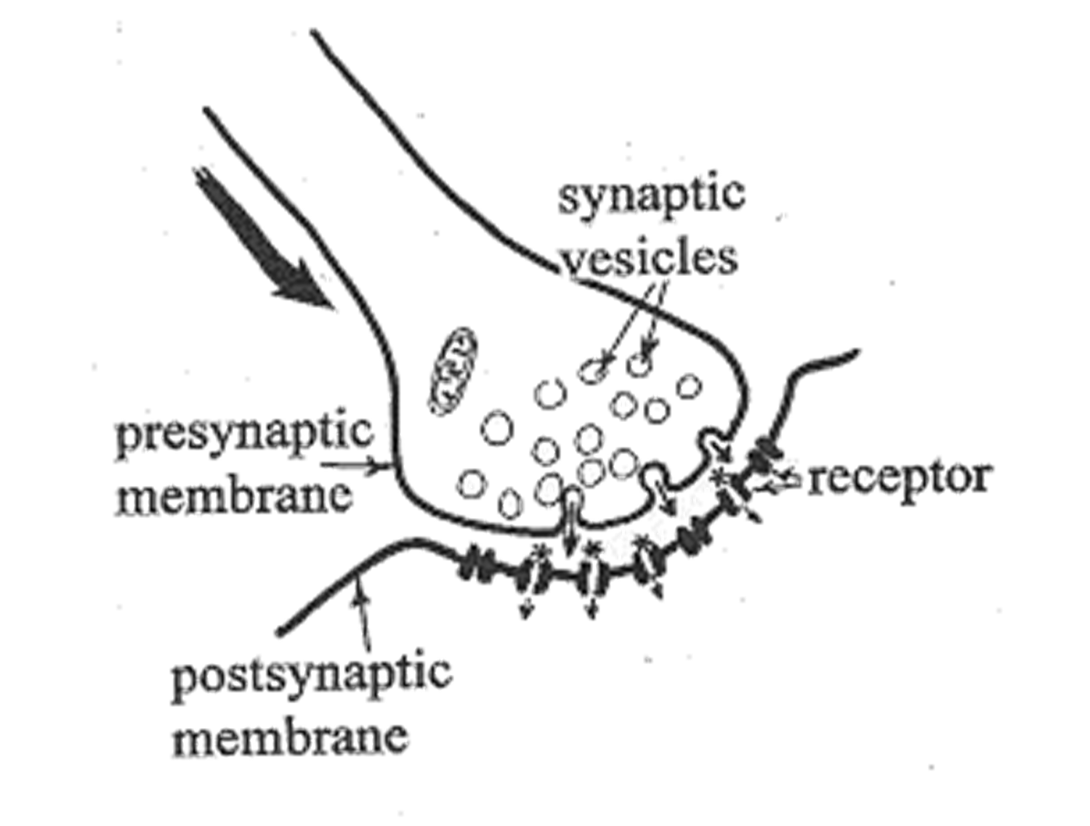

Slide 29
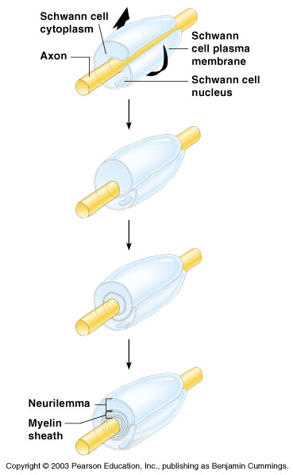
Nerve Fiber Coverings
Schwann cells – produce myelin sheaths in jelly-roll-like fashion
Nodes of Ranvier – gaps in myelin sheath along the axon

Slide 30
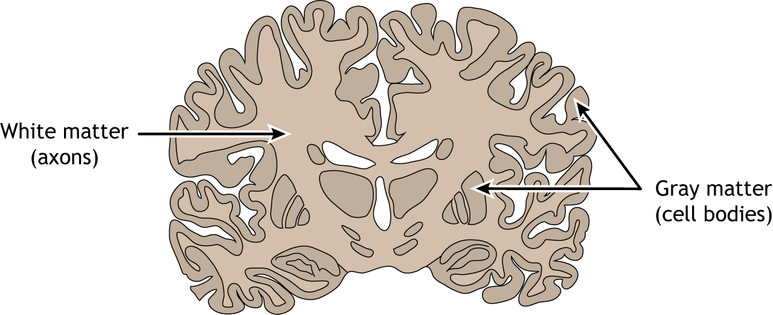
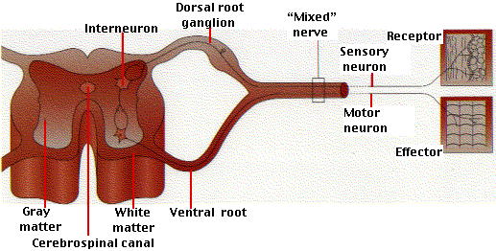
Neuron Cell Body Location
Most are found in the central nervous system
Gray matter – cell bodies and unmyelinated fibers
Nuclei – clusters of cell bodies within the white matter of the central nervous system
Ganglia – collections of cell bodies outside the central nervous system

Slide 31
Functional Classification of Neurons
Sensory (afferent) neurons
Carry impulses from the sensory receptors
Motor (efferent) neurons
Carry impulses from the central nervous system
Interneurons (association neurons)
Found in neural pathways in the central nervous system
Connect sensory and motor neurons

Slide 32
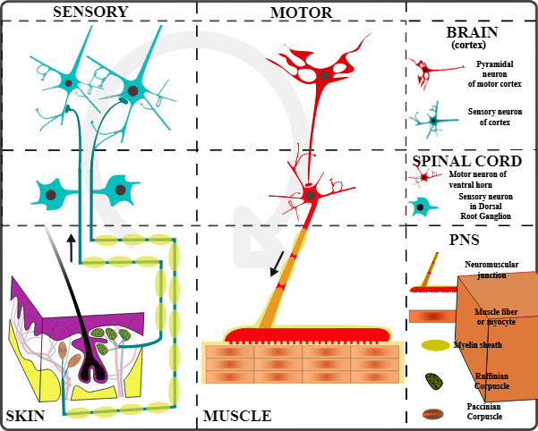

Slide 33
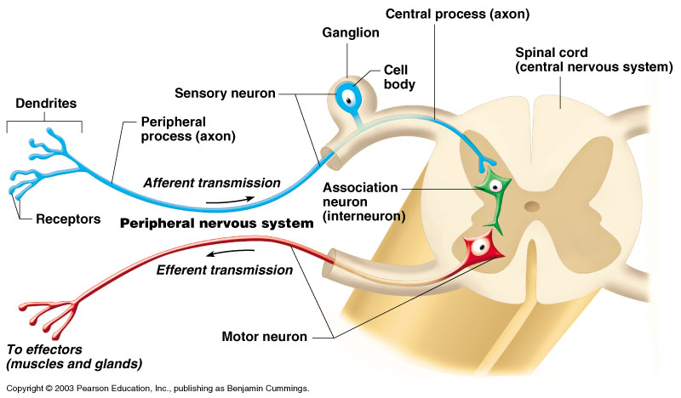
Neuron Classification
Sensory
Motor

Slide 34
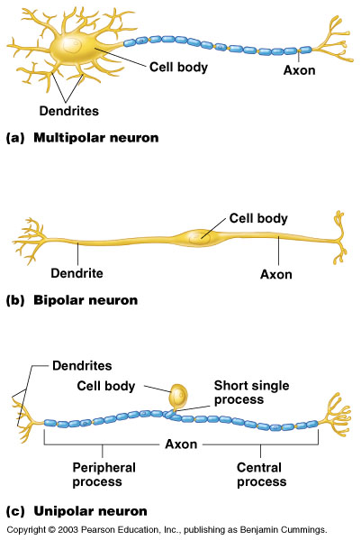
Structural classification of neurons
Multipolar neurons – many extensions from the cell body
Bipolar neurons – one axon and one dendrite
Unipolar neurons – have a short single process leaving the cell body

Slide 35
How Neurons Function
Irritability – ability to respond to stimuli
Conductivity – ability to transmit an impulse
The plasma membrane at rest is polarized
Fewer positive ions are inside the cell than outside the cell

Slide 36
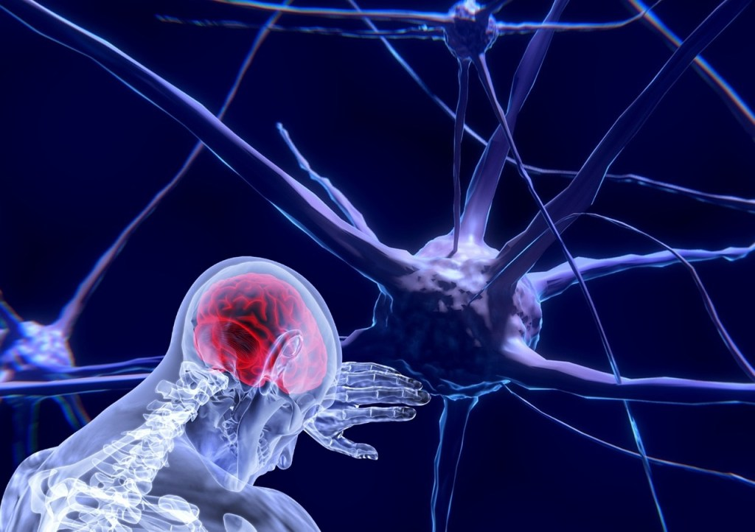
Sensory Physiology
Michael Ntim, Ph.D.
archangelmntim@yahoo.co.uk
Tel: 0507497320

Slide 37
Outline of Topics
Classification of Receptors
General Properties of Sensory Receptors.
Sensory Transduction
Sensation and Perception

Slide 38
Introduction
Sensory receptors are specialized epithelial cells or neuronal proteins that physically interact with a force, energy, or chemical and transduce the energy of the stimuli into a change in membrane potential.
Sensory receptors vary in classifications but generally initiate the same process of registering stimuli and creating nerve signals to be transmitted to the brain for interpretation.
With the information from the sensory receptors, the brain creates an internal representation of the external environment and alters organ function to maintain homeostasis.

Slide 39
Introduction
In a sensory system, sensory receptors serve as the front-liners because they are in contact with the stimulus.
By discovering sensory receptors and investigating their mechanisms, we can understand the pathophysiology of various disorders.
For example, understanding nociceptors is vital in designing new pharmaceutical solutions and treatment plans for chronic pain syndrome.

Slide 40
Classification of Sensory Receptors
Receptors can be classified based on;
Distribution;
Location of stimuli;
Morphology;
The type of stimulus to which they respond; and
Adaptation to stimulus

Slide 41
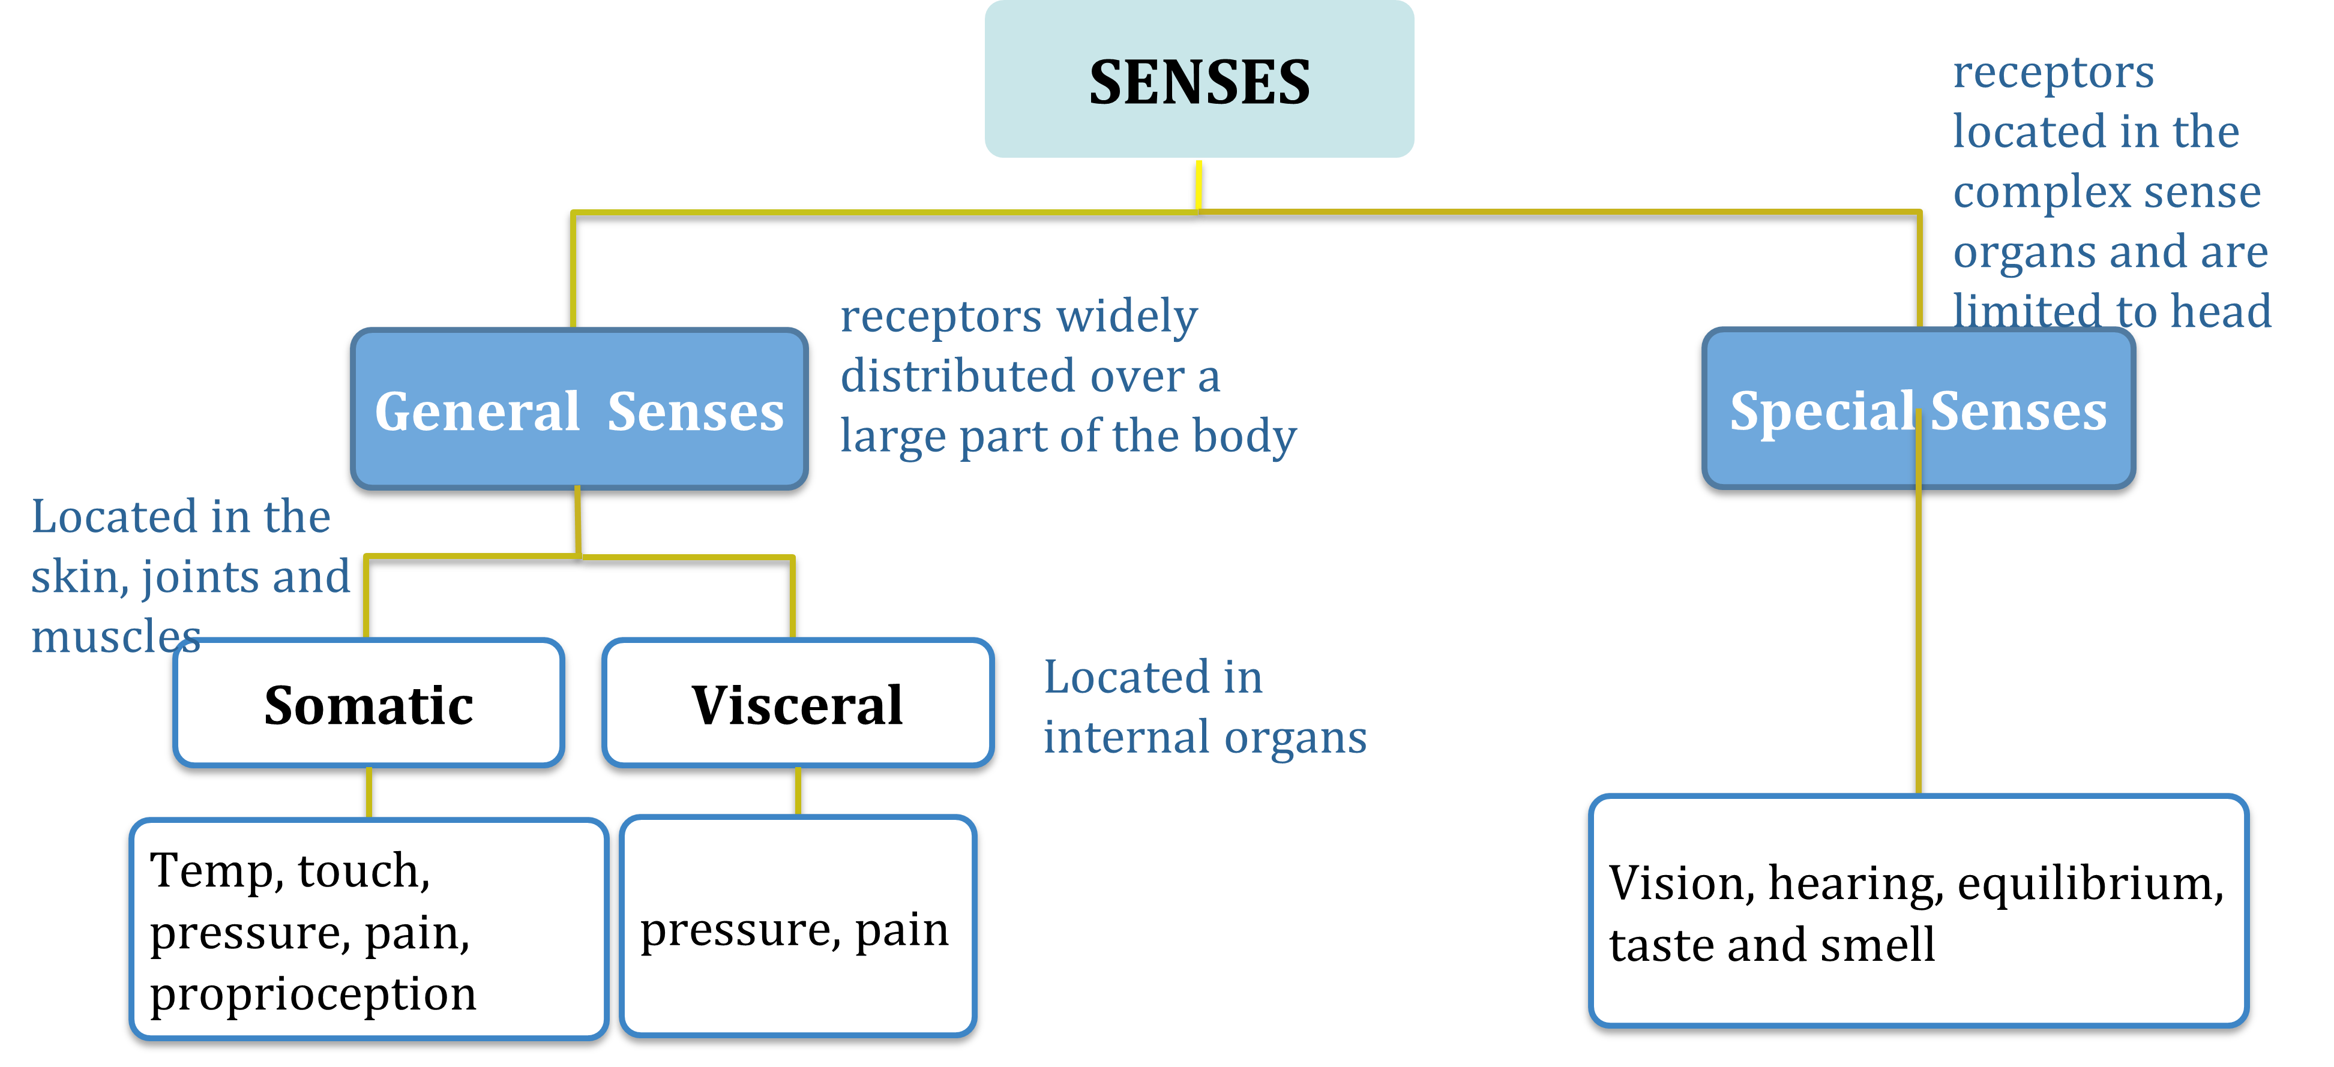
Classification of Receptors - By distribution

Slide 42
Classification of Sensory Receptors -By Location of stimuli
The three sensory receptors that are directly classified according to stimulus location include | Exteroceptors Proprioceptors Interoceptors or Visceroceptors
Exteroceptors: Any receptor that receives stimuli from the external environment | They react to pressure, touch, pain, and temperature in the skin, and also include most receptors of the special senses (hearing, vision, smell, and taste)

Slide 43
Classification of Sensory Receptors -By Location of stimuli
Interoceptors or Visceroceptors | Any receptor that detects stimuli (chemical changes, temperature, and tissue stretching) from the internal environment (blood vessels, bladder, stomach, uterus etc)
Proprioceptors are located within connective tissue coverings of bones and muscles, and muscles spindles, joints capsules, tendons and inner ear | provide information about the position of body segments relative to each other and the position of body and head in space and movement.

Slide 44
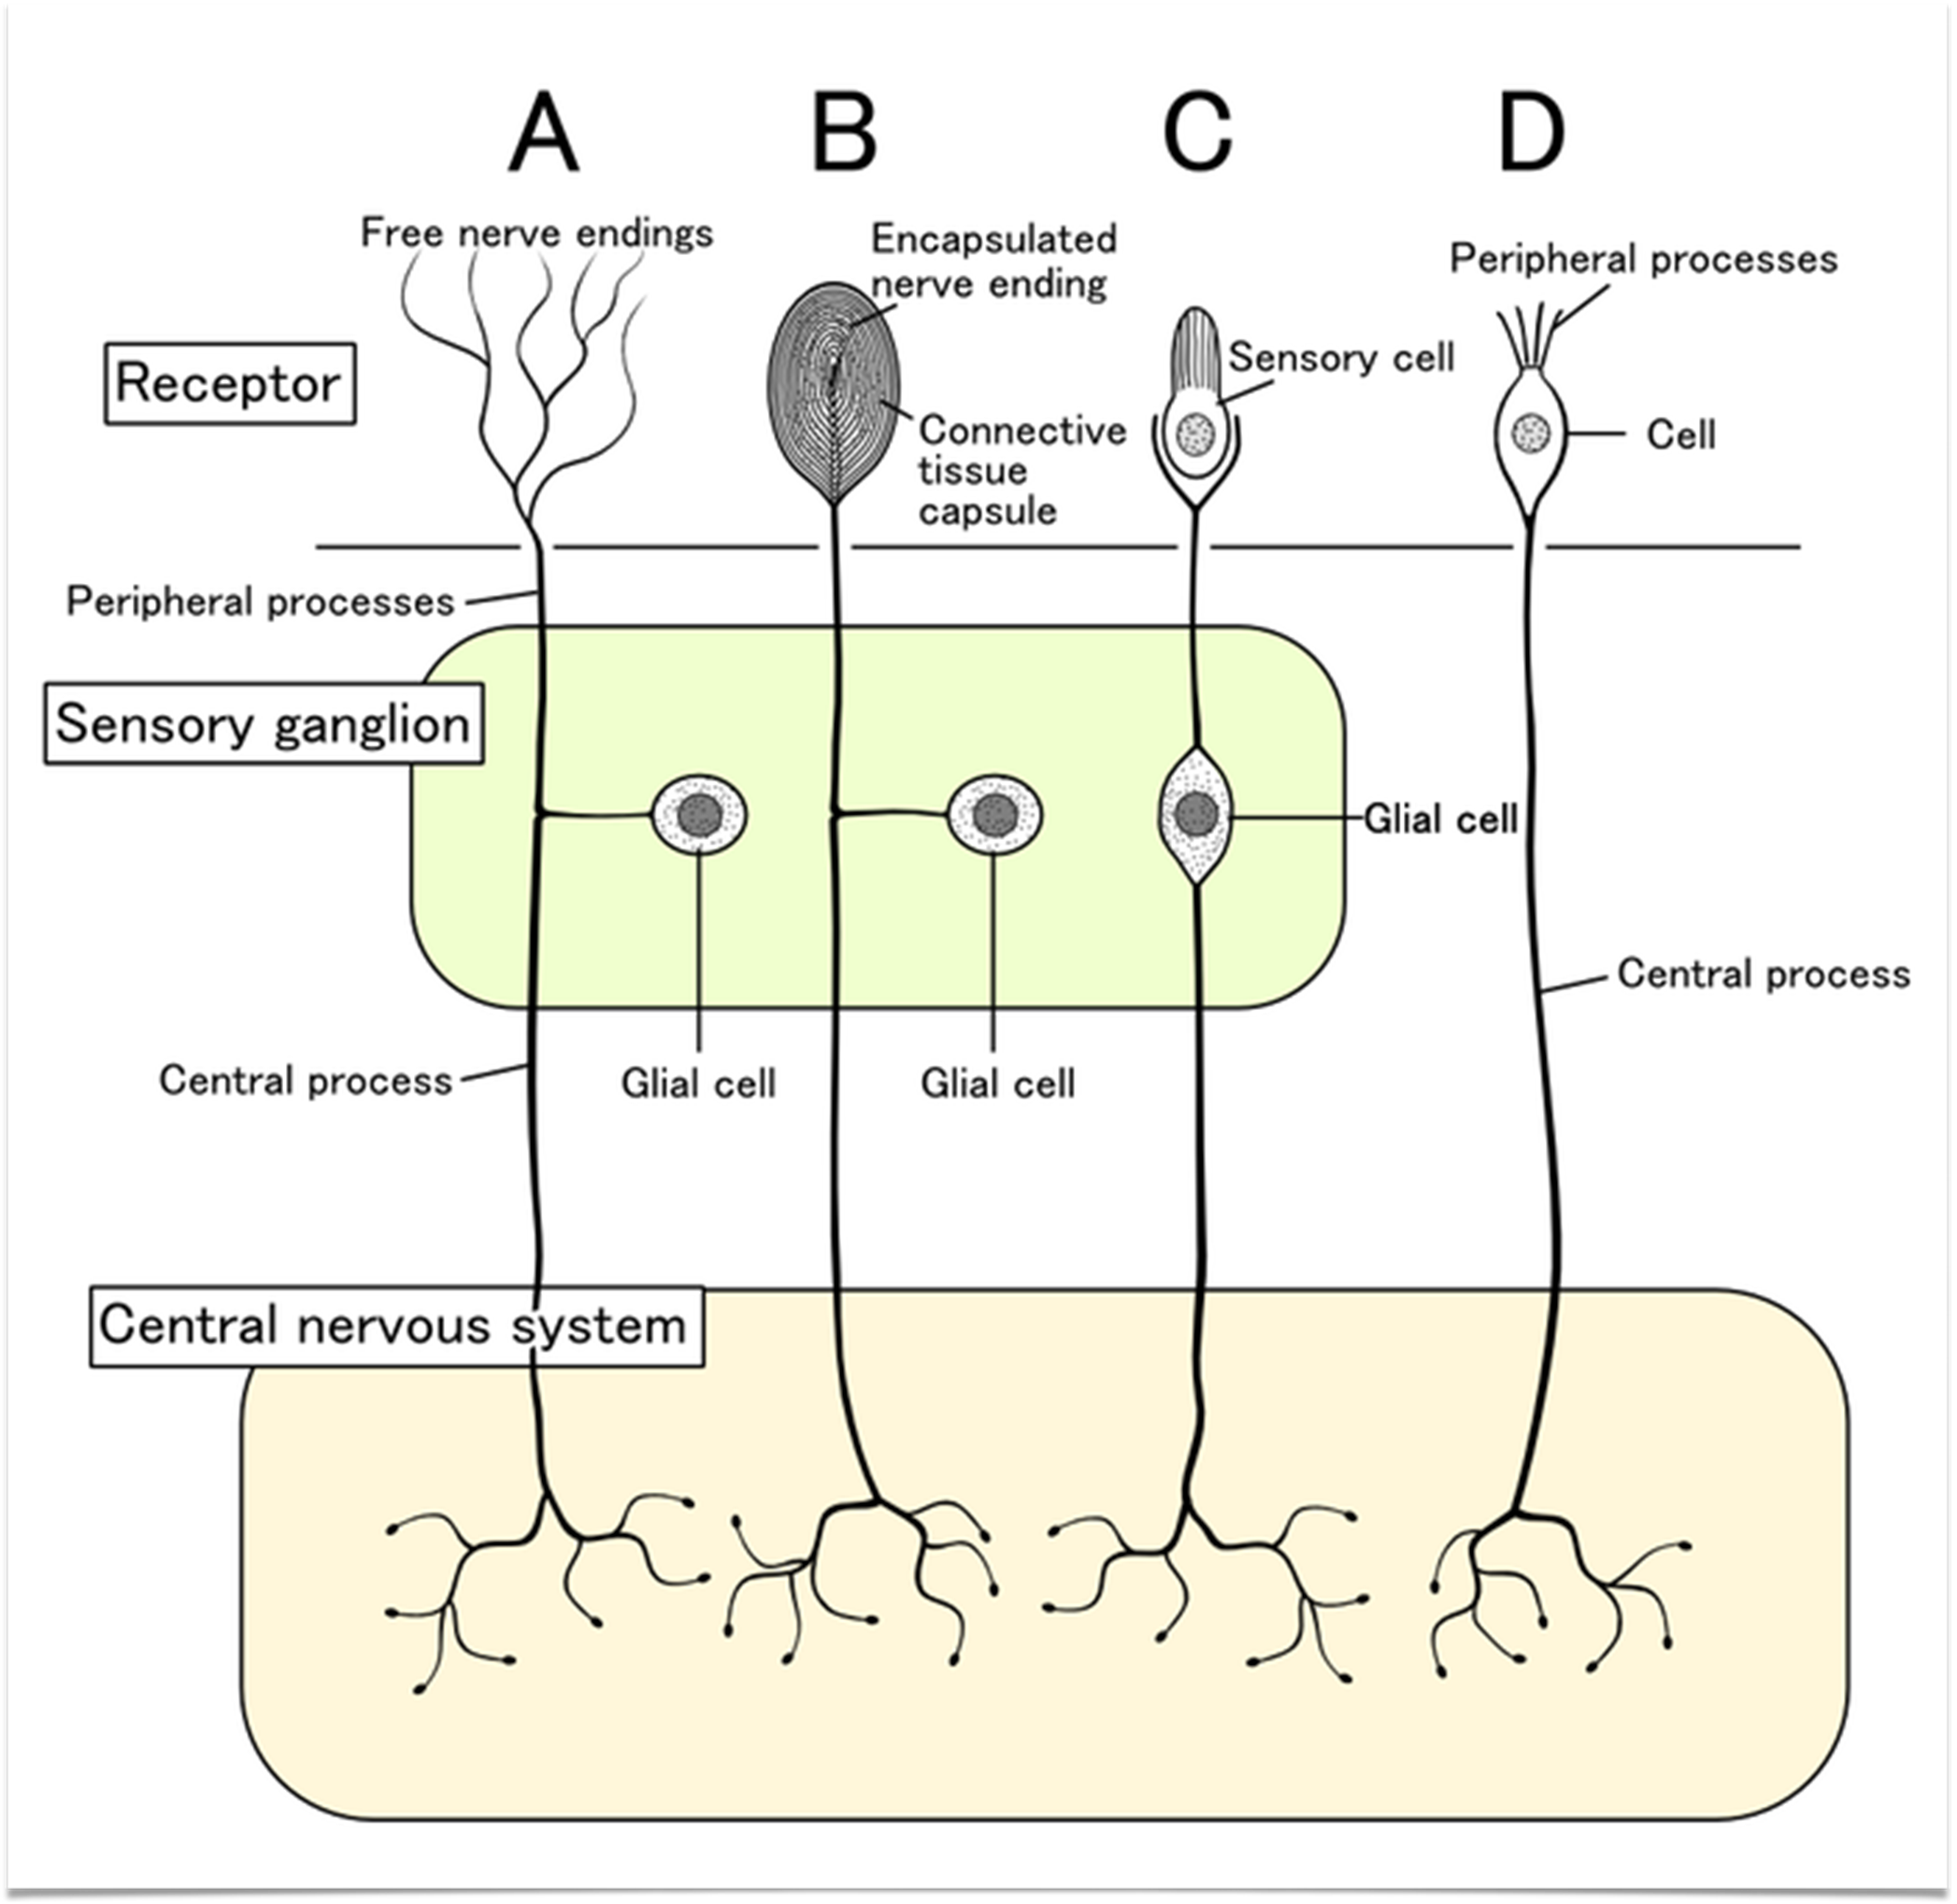
Classification of Receptors - By Morphology
A. Free nerve endings
bare dendrites
pain, temperature, tickle, itch and light touch
B. Encapsulated nerve endings
Dendrites enclosed in connective tissue capsule
Pressure, vibration and deep touch
C. Separate Sensory cells
Specialize cells that respond to stimuli
Vision, taste, hearing, balance

Slide 45
Classification of Receptors - By Modality
Stimulus modality is defined by the type of energy to which the sensory receptor reacts e.g., light, sound, taste, temperature, smell, pressure, etc.
Adequate stimulus is the ability of a sensory receptor to determine the stimulus modality.
Sensory receptors that are classified according to their adequate stimulus include the following:

Slide 46
Thermoreceptors: respond to temperature changes
Photoreceptors: react to light, including the receptors in the retinas of the eyes.
Nociceptors: respond to damaging stimuli, resulting in pain, which include extreme cold or heat, excessive pressure, and inflammatory chemicals
Chemoreceptors: respond to chemicals in a solution, such as molecules that are tasted or smelled, or any changes in chemistries of blood or interstitial fluid
Mechanoreceptors: react to mechanical forces, including BP, other types of pressure, touch, stretching, and vibrations

Slide 47
There are four classes of mechanoreceptors
Tactile receptors
Proprioceptors
Baroreceptors
Organ of Corti and vestibular system hair cells.

Slide 48
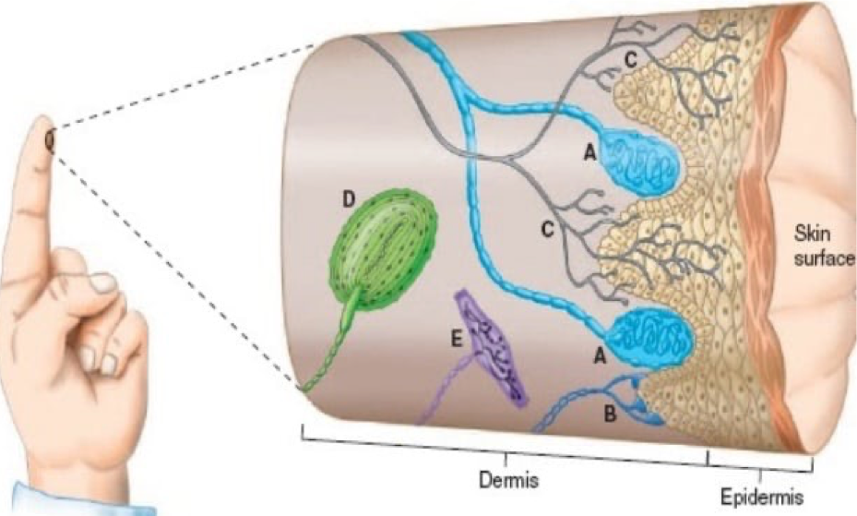
Mechanoreceptors
Tactile Receptors
There are six different types of mechanoreceptors detecting innocuous stimuli in the skin:
Meissner’s corpus
Merkel’s disks
Free nerve endings
Pacinian corpuscles
Ruffini corpuscles
and C-fiber LTM (low threshold mechanoreceptors
Notes:
Meissner’s corpuscles: encapsulated neurons that responds to low-frequency vibrations and fine touch
Merkel’s disks: encapsulated nerve endings that respond to light pressure and play a key role in differentiating textures.
Free nerve endings: fond in all connective tissues and are sensitive to painful stimuli, to hot and cold, and to light touch.
Pacinian corpuscles: deep receptors that respond to deep pressure and high-frequency vibration
Ruffini corpuscles: encapsulated receptors that respond to skin stretch
C-fiber LTMs detect pleasant, light tactile sensations

Slide 49
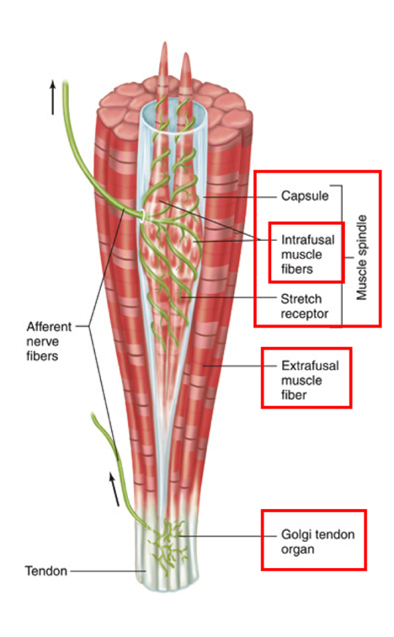
Mechanoreceptors
Proprioceptors
Proprioceptors are specialized mechanoreceptors that are usually present within muscle spindles, Golgi tendons, and joints
Proprioceptors report muscle length and movement information critical for motor control, limb position and position (proprioception).

Slide 50
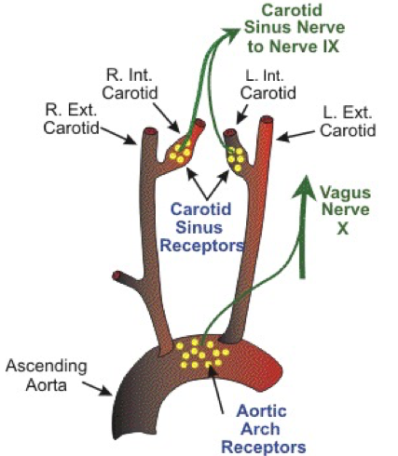
Mechanoreceptors
Baroreceptors
Baroreceptors detect pressure
Types
Carotid sinus & aortic baroceptors
alveolar stretch receptors
GI stretch receptors
urinary bladder stretch receptors

Slide 51
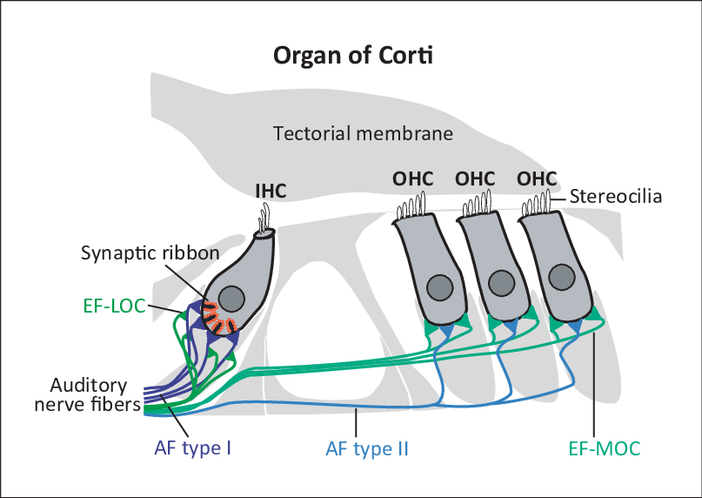
Mechanoreceptors
Organ of Corti and vestibular system hair cells
Hair cells of the inner ear are specialized mechanosensory cells, which convert mechanical stimuli provided by sound waves (cochlea) or head movement (vestibular system) into electrical signals.

Slide 52
Classification of Receptors - By Adaptation
Sensory Adaptation:
When applied stimulus acts for a prolonged duration, some receptors may stop responding in the course of time. So there will not be production of action potential in nerve fiber.
There are two (2) types of sensory receptor adaptations.

Slide 53
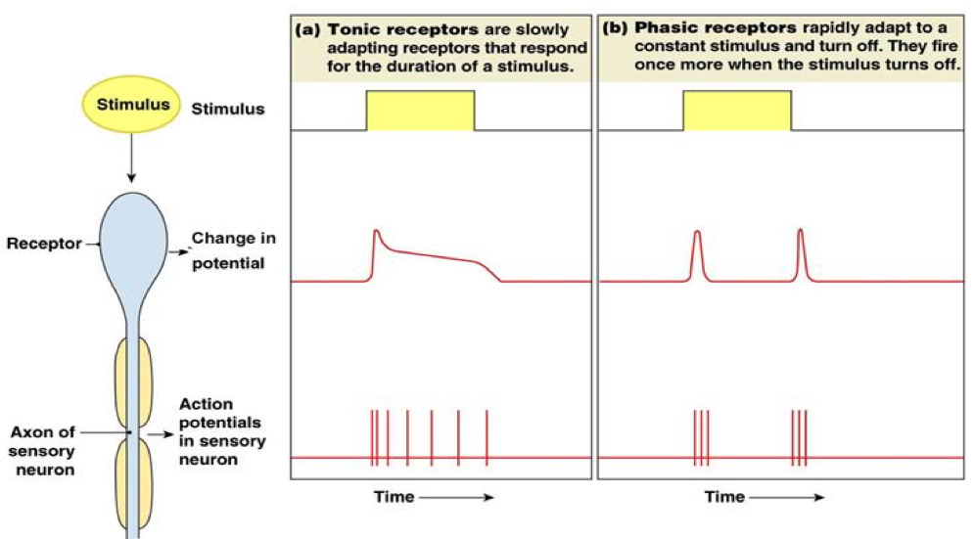
Tonic receptors —adapt slowly: generate nerve signals more steadily throughout the presence of the stimulus. e.g., Receptors that monitor body position, muscle tension, and joint motion.
Phasic receptors —adapt rapidly: generate a burst of action potentials when first stimulated, then quickly reduce or stop signaling even though the stimulus continues. e.g., olfactory receptors and touch receptors in the skin.
Notes:
Tonic receptors are slow adapting receptors. They will respond to the stimulus as long as it persists, and produce a continuous frequency of action potentials. Hence, they convey information about the duration of the stimulus.
Phasic receptors are rapidly adapting receptors. They will respond quickly to stimuli but stop responding upon continuous stimulation. Therefore, action potential frequency decreases during prolonged stimulation. This class of receptor conveys information about the changes to the stimulus such as intensity.

Slide 54
Sensory receptors in the skin have a different structure than sensory receptors in the eye. The most reasonable explanation for the difference in the structure of these receptors is that
Checkpoint
receptors in the skin are connected to nerve cells, but receptors in the eye are not.
receptors in the eye respond to a different type of input than receptors in the skin.
there are many more sensory receptors in the skin than receptors in the eye.
yellow
orange
green

Slide 55
Checkpoint
Group the following senses according to whether they use chemical or mechanical receptors
Which one can be both and which one is neither?
- chemoreptors
taste (gustation)
pain (nociception)
smell (olfaction)
Touch
Vibration
Vision
oxygen levels
pressure (baroreception)
- chemoreceptors and mechanorecptors
- chemorecptors
- mechanoreceptors
- mechanorecptors
- neither
- chemoreceptors
- mechanoreceptors

